Slide 1


File System Implementation in C++
An Object-Oriented Approach

Slide 2
Introduction
Project Description: Design and allow the execution of a file system by Object-Oriented Programming in C++. In the project, classes are formed for File, Directory and File System, and File Descriptor; and includes functionalities of File creation, deletion, reading and writing. Overview of the Presentation: Design Implementation Testing Approach Software Demonstration Conclusion

Slide 3

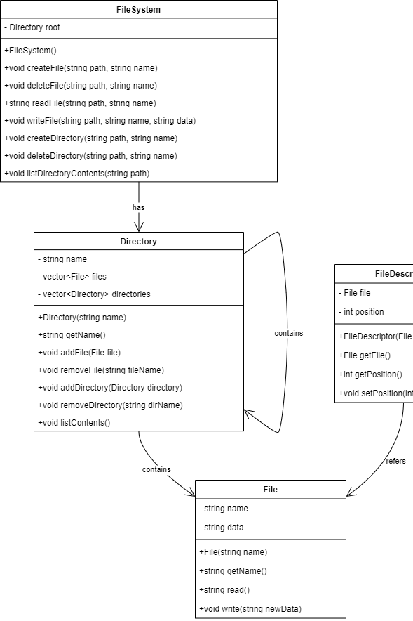
Design - UML Class Diagram
UML Class Diagram It has a single component, which depicts a structured overview of the conceptual nature of the entities involved in the modeling process. Description: The UML class diagram above defines the associations among the classes of the file system.

Slide 4
Design – explanation of the use of UML Diagram
File Class: Stands for a name and some data forming a certain file, which can be read and written.
Directory Class: Represents a directory that can contain files and other directories, allowing addition, removal, and listing of contents.
File System Class: Controls the root directory and offers the methods to create, delete, read, write a file, and work with directories. File Descriptor Class: Is a handle which holds a position in a file used for file operations.

Slide 5
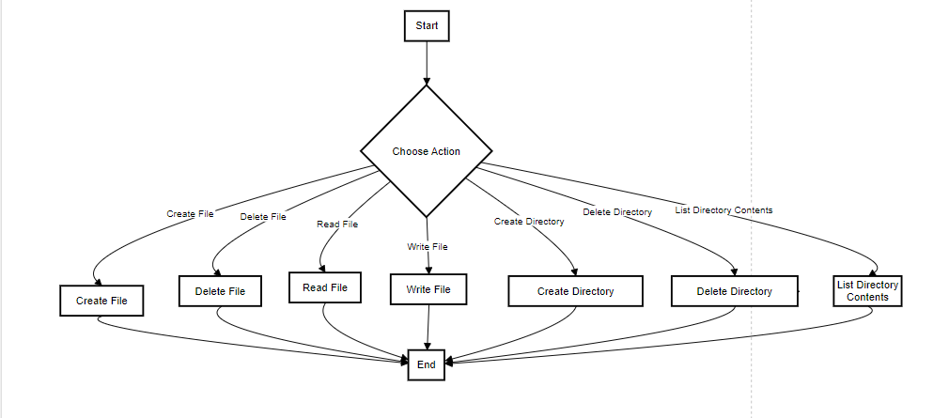
Design - Description of Use Case Diagram
Actors: User: The user who communicates with the file system in order to execute one or another action. Use Cases: Create File: User can create new objects such as new file in directory. Delete File: User can delete a file that he/she has created. Read File: User can sequentially read the contents of a file. Write File: User can also write data to a file. Create Directory: User can also easily create a new directory. Delete Directory: User can remove a particular directory since it is also one of the functionalities of the program. List Directory Contents: User can get the listing of all the contents in a particular directory.

Slide 6


Implementation : Strategy
Description: The conversion of the UML design into the functional C++ automated required developing of every class along with their methods and variables. Details: Described classes and their methods in the form of headers. Implemented methods in the source files which are used for the corresponding class. Standard libraries for vectors and strings were used in this program. Made the design modular and encapsulated for easy testing and managing of the system in case of improvements and/or bugs.

Slide 7

Implementation - Version Control
Description: The actual version control was utilized in handling several updates and tracking the history of the work done. Details: Tool Used: Git, with repository on GitHub. Commit Strategy: New commits for each mode with commit messages that can be easily understood for each new update. Branching: Maintenance of two different branches one is for features and second is for bug resolving.

Slide 8
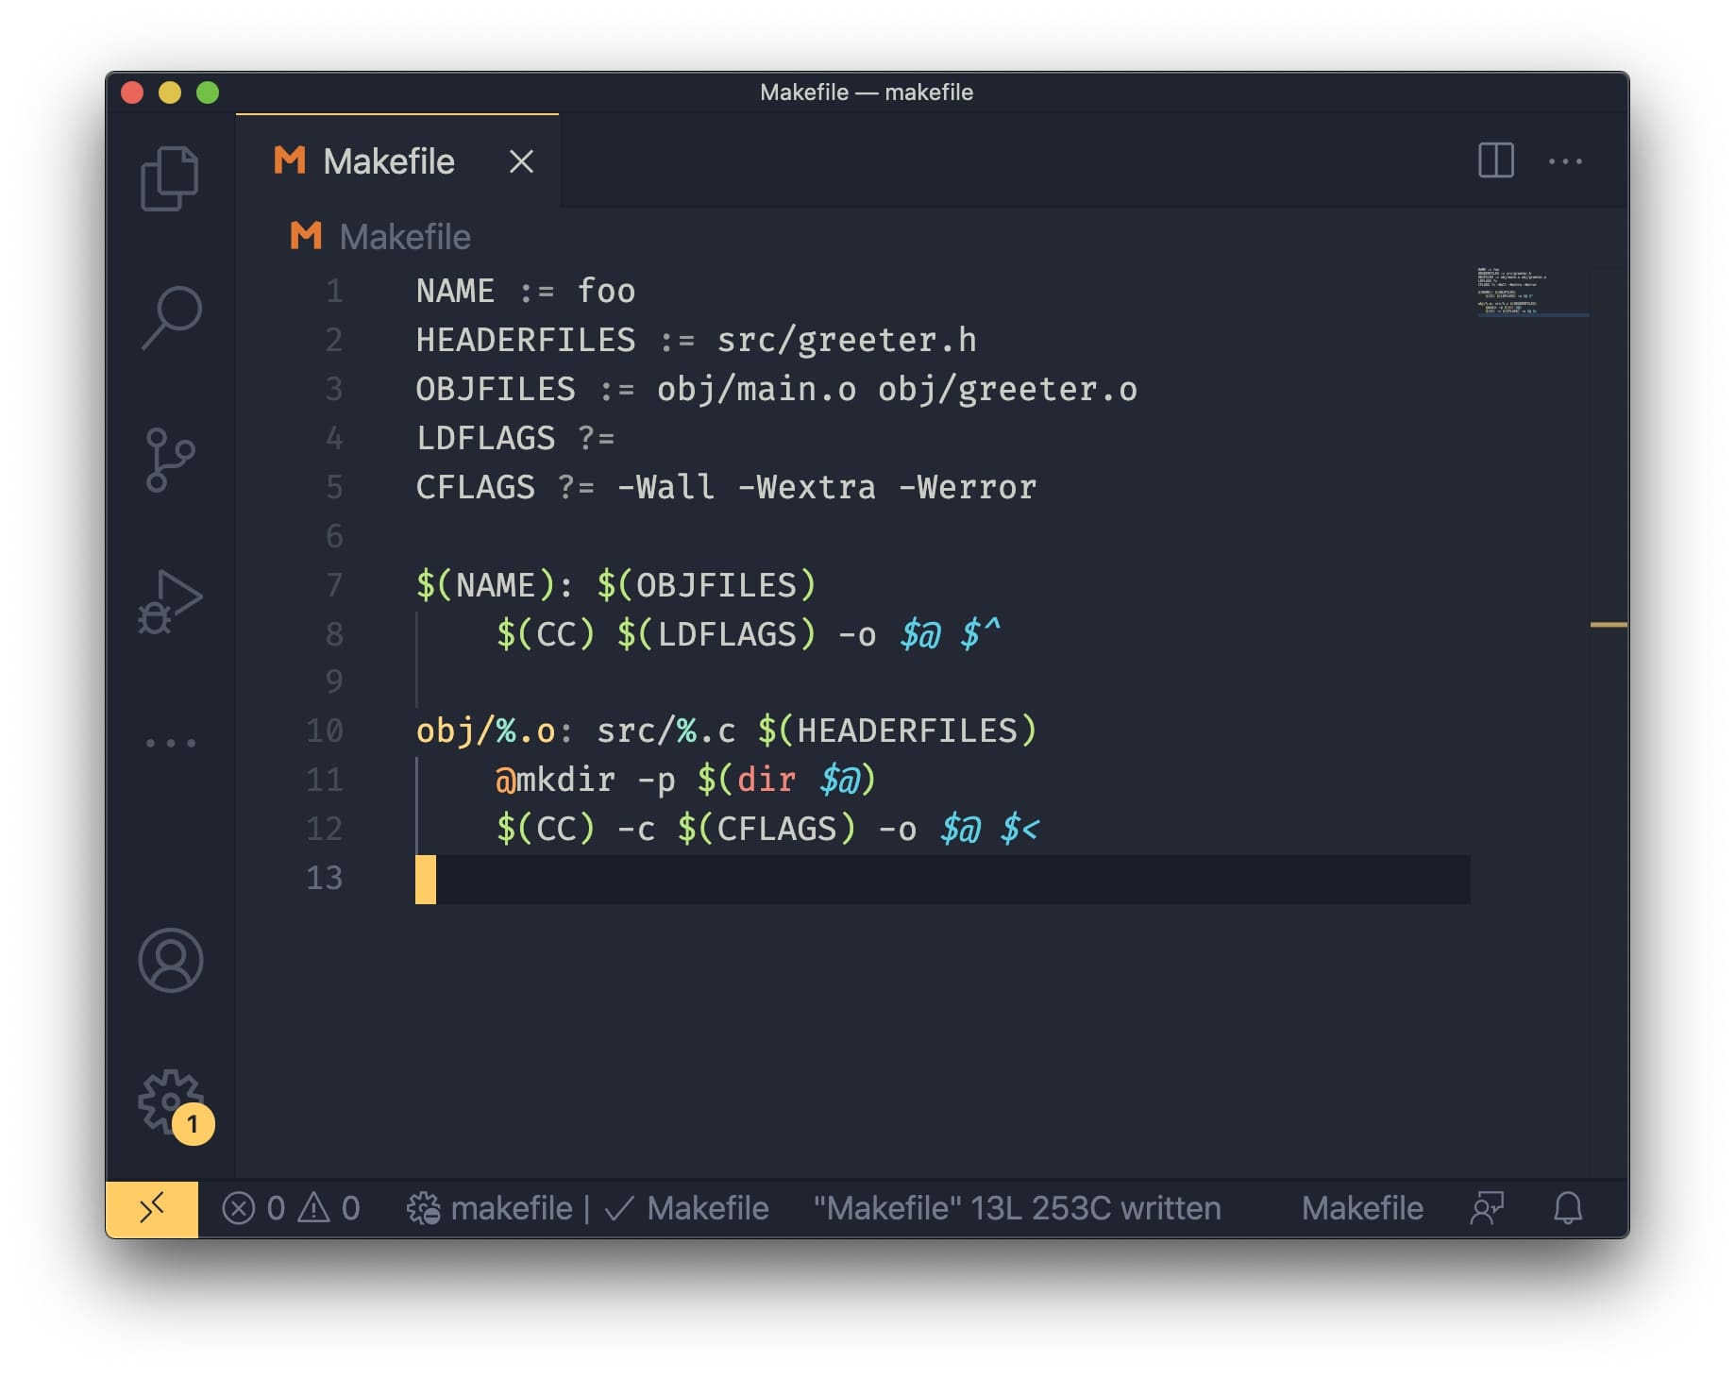
Implementation - Makefile
Description: The Makefile is used for automating the build process. Explanation: Defines the compiler and the flags passed to it. Brings a listing to the source files and their object file counterparts. Specifies the manner in which the source files will be assembled and the object files in the make executable file. It has a clean target that eliminates compiled files and a test target for running tests.

Slide 9

Testing Approach
Approach: Incorporated the Catch2 testing framework to create unit tests for the file system. Details: Test Cases: Explained how files are created, deleted, and read from/write to; regarding directories and various errors. Methodology: Generated unit tests to the classes and methods to make sure each of them work properly. Tools: Catch2 framework that is linked to the build process by the Makefile.

Slide 10

Testing - Test Cases
Description: Specific information on the test cases that were utilized to assure the functionality of the file system. Examples: File Operations: Was able to test creation of file, reading the file, writing to the file and deletion of the file. Directory Operations: Explored how to create directories, list their contents as well as creating and deleting files and directories within the tested directories.

Slide 11
Software Demonstration
Understanding the Implementation: File Operations: Explain step by step procedure of creating a file writing some data into that file, reading some data from the file, and finally deleting that file. Directory Operations: Illustrate creating of a directory, adding files and subdirectories into it, listing the contents of the directory and removal of the directories.

Slide 12

Conclusion
Summary: The project culminated in developing the file system with the basic operations on files and directories in the C++ using concepts related to Object-Oriented programming. Limitations: Current implementation does not support advanced features like file permissions, multi-user environments, or file system persistence across sessions. Future Approach: Some suggestions that may be useful for the subsequent developments are better generalized error reporting, improved script performance, and adoption of possibility to use stable storage.

